Slide 1
What is HTTPS
Secured HTTP via SSL/TLS protocols
SSL/TLS work on the application layer just below the HTTP.
In case a connection has HTTPS, the certificates are exchanged between the client and server.
Exchange symetric keys via asymmetric keys. Use public keys for exchange of keys for the session.
Done to prevent man-in-the-middle attack

Slide 2
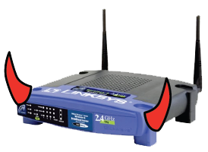
Threat Model: Network Attacker
Network Attacker:
Controls network infrastructure: Routers, DNS
Passive attacker: only eavesdrops on net traffic
Active attacker: eavesdrops, injects, blocks, and modifies packets
Examples:
Wireless network at Internet Café
Internet access at hotels (untrusted ISP)

Slide 3
SSL/TLS overview
Public-key encryption:
Alice
Bob
m
Enc
c
c
Dec
m
PK_{Bob}
SK_{Bob}
Bob generates (SK_{Bob} , PK_{Bob} )
Alice: using PK_{Bob} encrypts messages and only Bob can decrypt

Slide 4

Certificates
How does Alice (browser) obtain PK_{Bob} ?
Browser Alice
Server Bob
CA
choose
(SK,PK)
PK and
proof “I am Bob”
check
proof
PK_{CA}
PK_{CA}
SK_{CA}
issue Cert with SK_{CA} :
verify
Cert
Bob’s key is PK
Bob’s key is PK
Bob uses Cert for an extended period (e.g. one year)

Slide 5
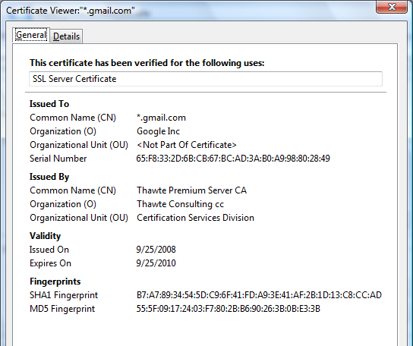
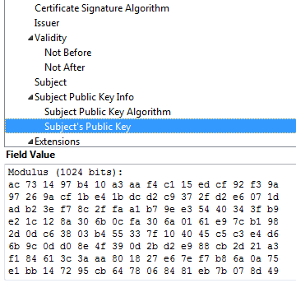
Certificates: example
Important fields:

Slide 6
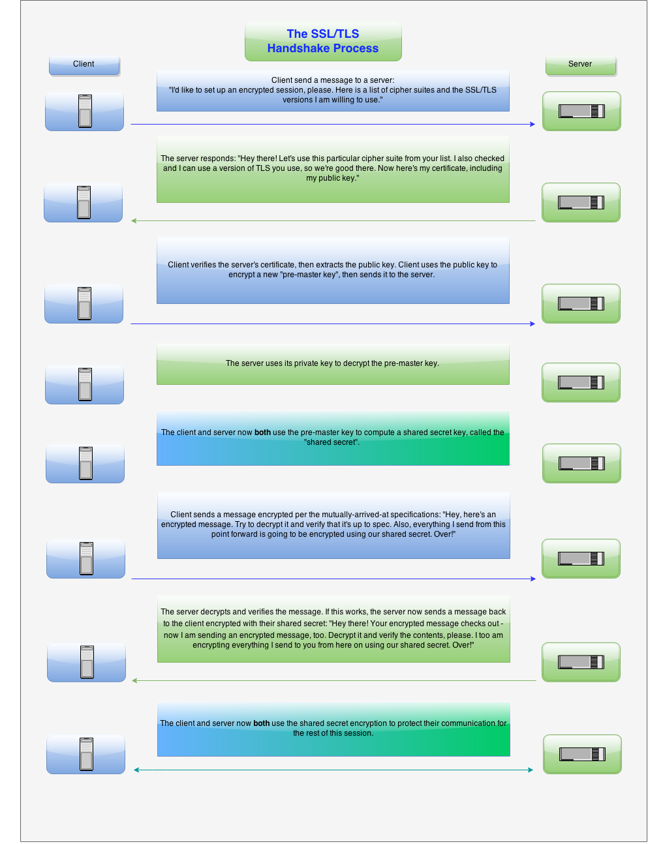
SSL/TLS Handshake Process

Slide 7
TLS protocol
Subsequent version of SSL. A new version of TSL is drafted by W3 consortium.
Works on exchanging cipher suite (encryption algorithm, message authentication code (MAC)
MAC – key generation, signing, verifying.
Block ciphers are used to follow the cipher suite for a particular block (stream of messages)
Prone to Chosen CipherText Attack.

Slide 8
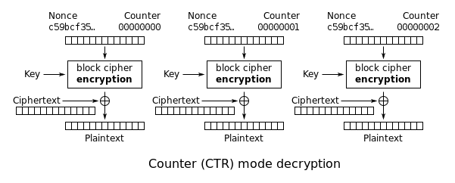
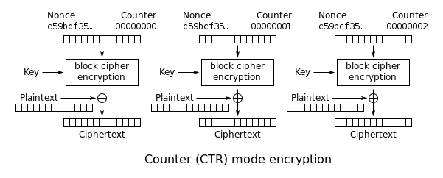
EAX mode using Counter for Block Ciphers

Slide 9
How to create a certificate using OpenSSL
The keys generated are either 4096 or 2048 bits long. Obviously, 4096 is more secure, but slows down the TSL handshake process between the client and server.
Create root certificate authorities that can verify many more intermediate authorities
Create intermediate authorities
Create the certificate. For client certificates, use localhost as commonname.
More details on: https://jamielinux.com/docs/openssl-certificate-authority/introduction.html

Slide 10
Brief overview of SSL/TLS
browser
server
client-hello
cert
server-hello + server-cert (PK)
SK
key exchange (several options)
rand. k
client-key-exchange: E(PK, k)
k
Finished
HTTP data encrypted with KDF(k)
Most common: server authentication only

Slide 11
Integrating SSL/TLS with HTTP ⇒ HTTPS
web proxy
Two complications
Web proxies
solution: browser sends
CONNECT domain-name
before client-hello (dropped by proxy)
Virtual hosting:
two sites hosted at same IP address.
solution in TLS 1.1 (RFC 4366)
client_hello_extension: server_name=cnn.com
implemented in FF2 and IE7 (vista)
web server
corporate network
web server
client-hello
server-cert ???
cert_{CNN}
cert_{FOX}

Slide 12
Why is HTTPS not used for all web traffic?
Slows down web servers
Breaks Internet caching
ISPs cannot cache HTTPS traffic
Results in increased traffic at web site
Incompatible with virtual hosting (older browsers)

Slide 13
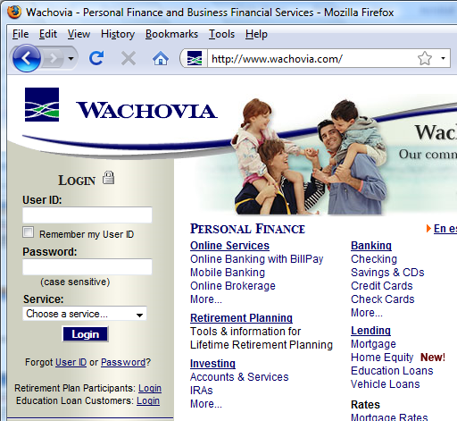
HTTPS and login pages: incorrect version
Users often land on login page over HTTP:
Type site’s HTTP URL into address bar, or
Google links to the HTTP page
View source:
<form method="post"
action="https://onlineservices.wachovia.com/..."
Notes:
User has no way to tell that his password is sent over HTTPS to site. Also has no way to tell that page wasn’t modified enroute (e.g. change form action).
Note the confusing lock next to “LOGIN” that suggests this is HTTPS.

Slide 14
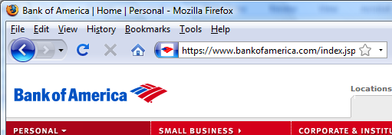
HTTPS and login pages: guidelines
General guideline:
Response to http://login.site.com should be Redirect: https://login.site.com

Slide 15
Problems with HTTPS and the Lock Icon

Slide 16
Problems with HTTPS and the Lock Icon
Upgrade from HTTP to HTTPS
Semantic attacks on certs
Invalid certs
Mixed content
HTTP and HTTPS on the same page
Origin contamination
Weak HTTPS page contaminates stronger HTTPS page

Slide 17
1. HTTP → HTTPS upgrade
Common use pattern:
browse site over HTTP; move to HTTPS for checkout
connect to bank over HTTP; move to HTTPS for login
Easy attack: prevent the upgrade (ssl_strip) [Moxie’08]
<a href=https://…> ⇒ <a href=http://…>
Location: https://... ⇒ Location: http://... (redirect)
<form action=https://… > ⇒ <form action=http://…>
HTTP
SSL
attacker
web server
Notes:
ssl_strip: prevents browser from upgrading, but does the SSL upgrade when communicating with the server. Server has no idea this is taking place.

Slide 18
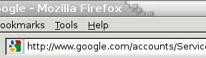
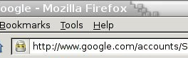
Tricks and Details
Tricks: drop-in a clever fav icon
Details:
Erase existing session and force user to login:
ssl_strip injects “Set-cookie” headers to delete existing session cookies in browser.
Number of users who detected HTTP downgrade: 0
⇒

Slide 19
2. Semantic attacks on certs
International domains: xyz.cn
Rendered using international character set
Observation: chinese character set contains chars that look like “/” and “?” and “.” and “=”
Attack: buy domain cert for *.badguy.cn
setup domain called:
www.bank.com/accounts/login.php?q=me.baguy.cn
note: single cert *.badguy.cn works for all sites
Extended validation (EV) certs may help defeat this

Slide 20
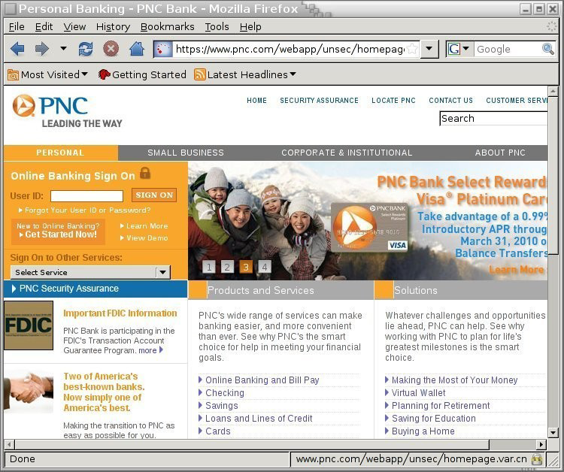
[Moxie’08]

Slide 21
3. Invalid certs
Examples of invalid certificates:
expired: current-date > date-in-cert
CommonName in cert does not match domain in URL
unknown CA (e.g. self signed certs)
Small sites may not want to pay for cert
Users often ignore warning:
Is it a misconfiguration or an attack? User can’t tell.
Accepting invalid cert enables man-in-middle attacks (see http://crypto.stanford.edu/ssl-mitm )

Slide 22
Man in the middle attack using invalid certs
GET https://bank.com
BadguyCert
BankCert
attacker
ClientHello
ClientHello
bank
ServerCert (Badguy)
ServerCert (Bank)
bad cert
warning!
SSL key exchange
SSL key exchange
k₁
k₁
k₂
k₂
HTTP data enc with k₁
HTTP data enc with k₂
Attacker proxies data between user and bank. Sees all traffic and can modify data at will.

Slide 23
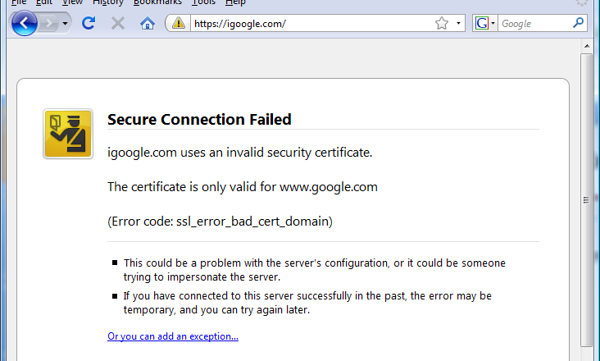
Firefox: Invalid cert dialog
Firefox 3.0: Four clicks to get firefox to accept cert
page is displayed with full HTTPS indicators

Slide 24
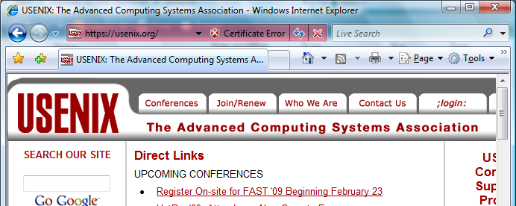
IE: invalid cert URL bar

Slide 25
4. Mixed Content: HTTP and HTTPS
Page loads over HTTPS, but contains content over HTTP
(e.g. <script src=“http://.../script.js> )
IE7: displays mixed-content dialog and no SSL lock
Firefox 3.0: displays `!’ over lock icon (no dialog by default)
Both browsers:
Flash swf file over HTTP does not trigger warning !!
note: Flash can script the embedding page
Safari: does not attempt to detect mixed content

Slide 26
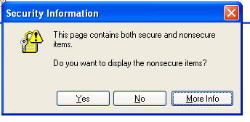
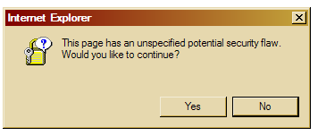
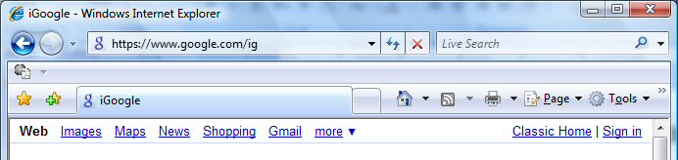
Mixed Content: HTTP and HTTPS
silly dialogs
IE7:
No SSL lock in address bar:

Slide 27
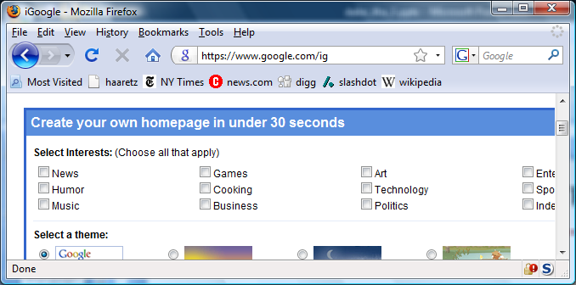
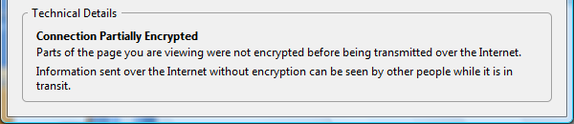
Mixed Content: HTTP and HTTPS
Firefox 3.0:
No SSL indicator in address bar
Clicking on bottom lock gives:

Slide 28
Mixed content and network attacks
banks: after login all content served over HTTPS
Developer error: somewhere on bank site write
<embed src=http://www.site.com/flash.swf>
Active network attacker can now hijack session
Better way to include content:
<embed src=//www.site.com/flash.swf>
served over the same protocol as embedding page

Slide 29
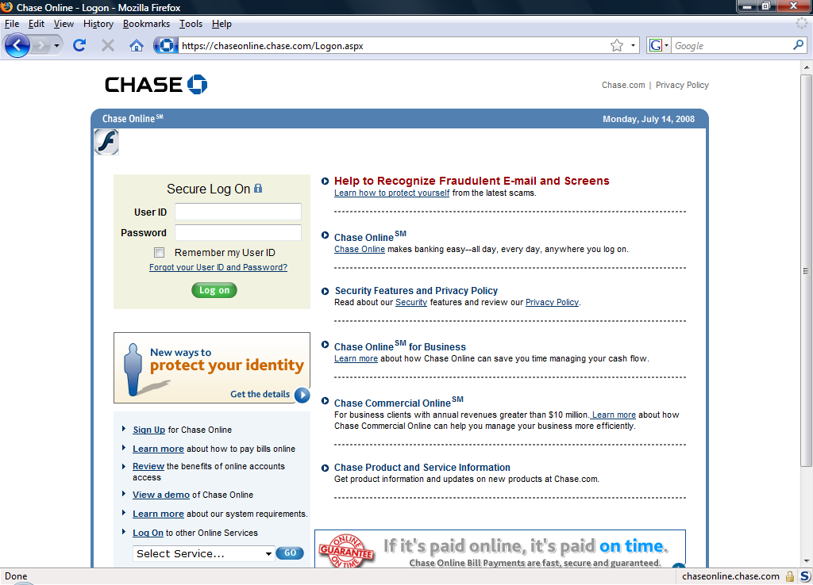
An Example From an Online Bank
…
var so = new SWFObject("http://mfasa.chase.com/auth/device.swf", ...
network attacker can modify SWF file and hijack session
(the site has been fixed)

Slide 30
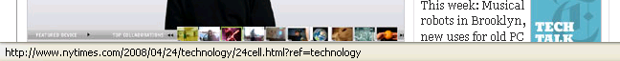
Final note: the status Bar
Trivially spoofable
<a href=“http://www.paypal.com/”
onclick=“this.href = ‘http://www.evil.com/’;”>
PayPal</a>

Slide 31
THE END

